Slide 1
CHECKPOINT #1
Manmeet Singh Hayer
CSC498: SENIOR SEMINAR
THURSDAY SEPT 25, 2025

Slide 2
AGENDA
Quick Background
Home Dashboard
Candlestick Charts (with ranges)
Navigation Setup
Demo Video Placeholder
Challenges (if time)

Slide 3
BACKGROUND
Finvestor = stock-market education web app
Lets students explore watchlists, charts, paper trading (later)
Goal: make investing approachable & interactive

Slide 4
FIRST CHECKPOINT PROMISES
Home Page: Full with search bar, market overview & finance tips
Sidebar with main pages: Home, Ticker, Watchlists, Portfolios, Compare, Methods
Tickers: Candlestick shows open, high, low, close (OHLC); volume bars included as well
Time ranges: 1M, 3M, 6M, 1Y, 5Y, MAX

Slide 5
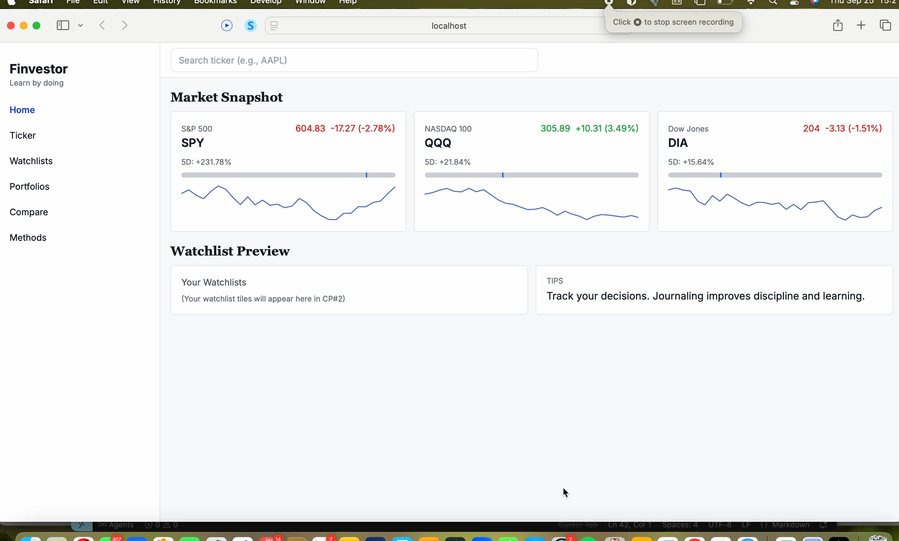
DEMONSTRATION

Slide 6
QUESTIONS?
THANK YOU!

